Slide 1

Internal Multiple Removal in Offshore Brazil Seismic Data Using the Inverse Scattering Series
Master Thesis
Andre S. Ferreira
Advisor: Dr. Arthur B. Weglein
November 15, 2011

Slide 2
Outline
Introduction and problem
Objectives
Theory
Data processing
Multiple attenuation
Conclusion

Slide 3
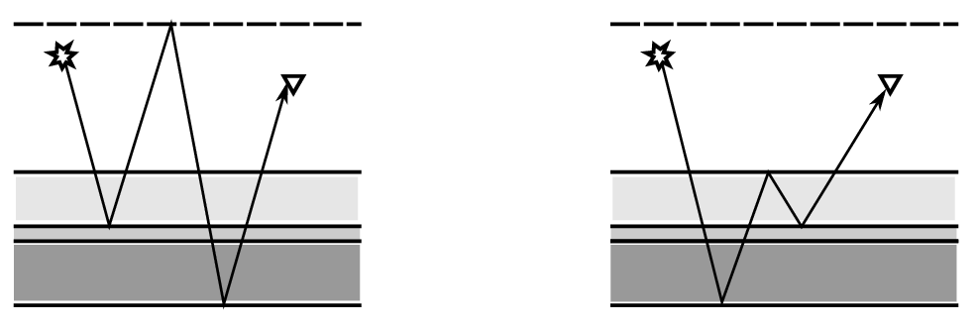
Introduction and problem
Multiples in seismic data
Air
Water
Only primaries are used for imaging and inversion
There are various methods to remove or attenuate multiples

Slide 4
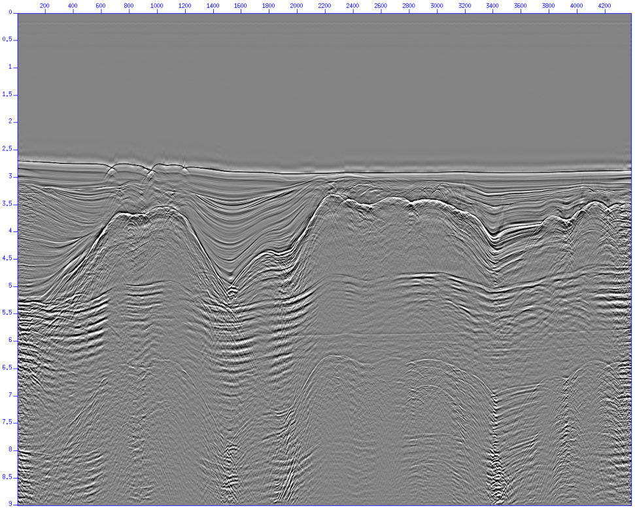
Introduction and problem
Petrobras dataset stack example (all multiples shown)
Salt domes
Salt layers

Slide 5
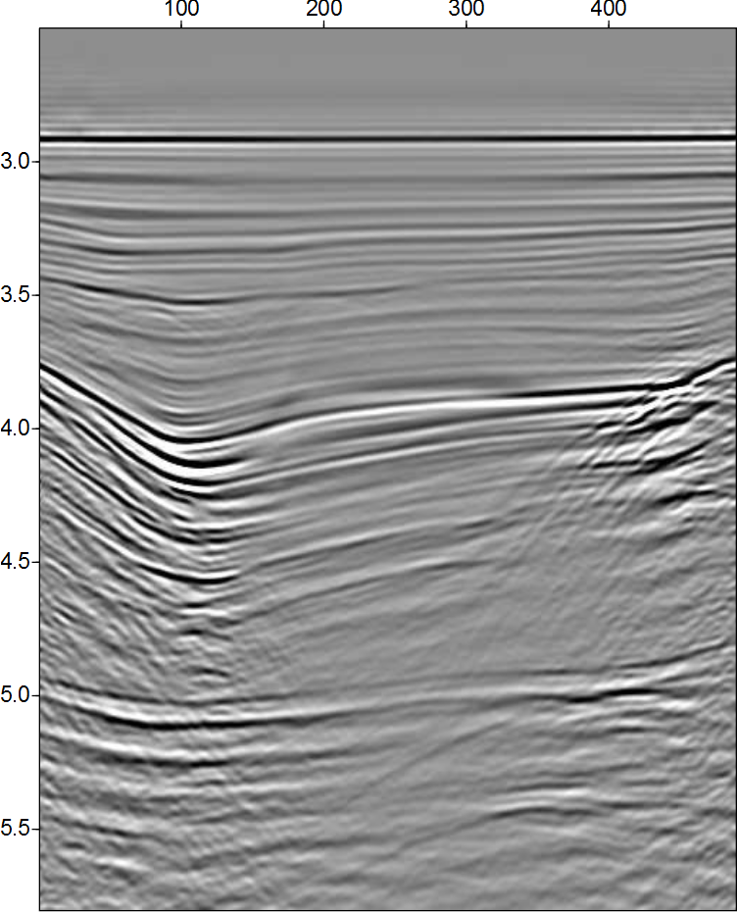
Introduction and problem
Multiple removal challenges
  Deal with complex structure
  Effective removal at short offsets
  Generators for internal multiples cannot be mapped
New method with fewer assumptions is needed
Several internal
multiple generators

Slide 6
Objectives
Review theory and applications of ISS methods
Reprocess a 2D Petrobras seismic line extracted from 3D to the requirements of ISS multiple attenuation
Apply ISS multiple attenuation methods to the data
  ISS methods are direct data driven and do not require any a priori information
  ISS methods work on data with complex structure, on all offsets, and no reflector mapping is necessary
  Any improvement in multiple attenuation will be relevant

Slide 7
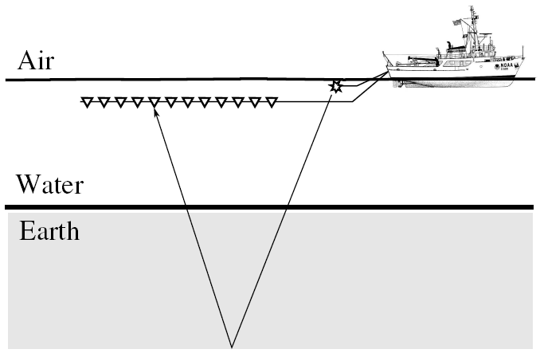
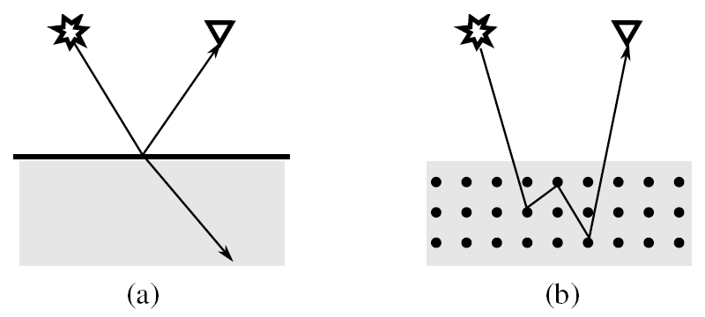
Theory
Marine seismic experiment:
Scattering theory view:

Slide 8
Theory
Forward problem and inverse problem
?
(forward)
OK
OK
?
OK
OK
(inverse)

Slide 9
Theory
Reference medium and perturbation (marine case)
air
air
water
water
=
+
earth
perturbation
Actual medium
Reference medium
Perturbation

Slide 10



Theory
Reference medium and perturbation (marine case)
air
air
water
water
=
+
earth
perturbation
Actual medium
Reference medium
Perturbation
Linear operator describing the actual medium
Green’s function describing the actual wavefield

Slide 11



Theory
Reference medium and perturbation (marine case)
air
air
water
water
=
+
earth
perturbation
Actual medium
Reference medium
Perturbation
Linear operator describing the reference medium
Green’s function describing the reference wavefield

Slide 12

Theory
Reference medium and perturbation (marine case)
air
air
water
water
=
+
earth
perturbation
Actual medium
Reference medium
Perturbation
(Lippmann-Schwinger Equation)

Slide 13
Theory
Equation describing the actual medium:
Linear operator describing the actual medium
Green’s function describing the actual wavefield
Equation describing the reference medium:
Linear operator describing the reference medium
Green’s function describing the reference wavefield
Relation between actual and reference medium
(Lippmann-Schwinger Equation)

Slide 14
Theory
Forward scattering series:
  Solves for the actual wavefield as a function of the reference medium and subsurface properties
  The series is non-linear. Truncation at the first order term leads to the Born linear approximation
  There is a direct relation between the traditional seismic reflection view and the scattering approach
  However, the goal of seismic is to solve for subsurface properties (inverse problem)

Slide 15
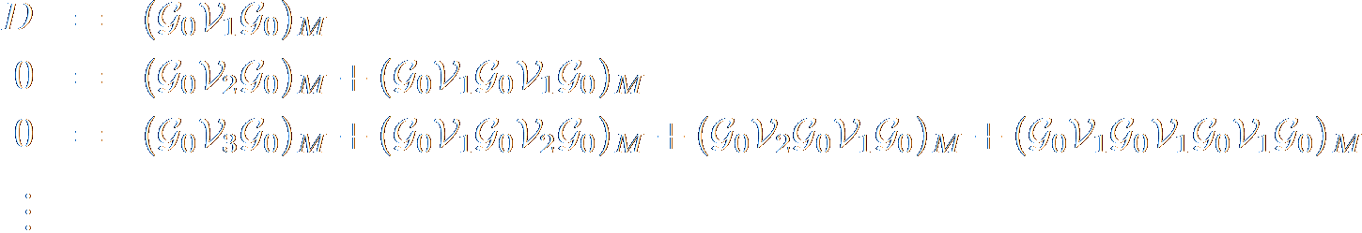
Theory
Inverse Scattering Series (ISS):
  Solves for the perturbation operator as a function of the reference wavefield and the actual field measured on a surface (seismic data D)
  Direct and non-linear solution to the inverse problem

Slide 16
Theory
Subseries of the entire Inverse Scattering Series
  Subseries can be used to perform a specific task on the seismic data
  Subseries terms can be mapped from the relation between the series and the traditional reflection problem
  Multiple removal/attenuation subseries can be obtained by this mapping
    Free surface multiple removal subseries
    Internal multiple attenuation subseries

Slide 17
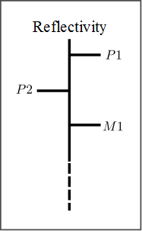


Theory
Inverse Scattering Series and mapping of terms
  Mapping between the scattering series and the traditional seismic problem
Map I
Map II

Slide 18
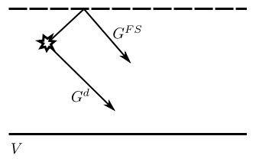
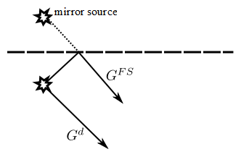



Theory
Reference Green’s function
  Reference medium = air and water separated by a free surface
(Direct Green’s function and free surface Green’s function)

Slide 19
Theory
Free surface removal subseries
  Inverse scattering series terms

Slide 20
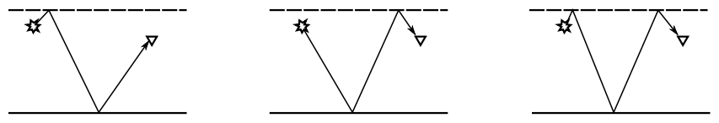




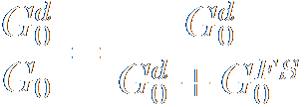

Theory
Deghosting
  Ghost: event that starts and/or ends its propagation with a reflection at the free surface
General series term:
Deghosting operation:
Multiply both sides by:
(projected on receiver and source sides)
Deghosted data:

Slide 21
Theory
ISS algorithm
  Identify task-specific terms in the entire series
    e.g.: identify the terms responsible for free surface multiple removal
  Employ the subseries to perform the specific task (data processing)
    e.g.: apply free surface multiple removal subseries to the dataset and obtain a processed dataset with multiples removed
  Restart the problem using the processed data as new input
    e.g.: the internal multiple attenuation uses the data with free surface multiples removed as input

Slide 22
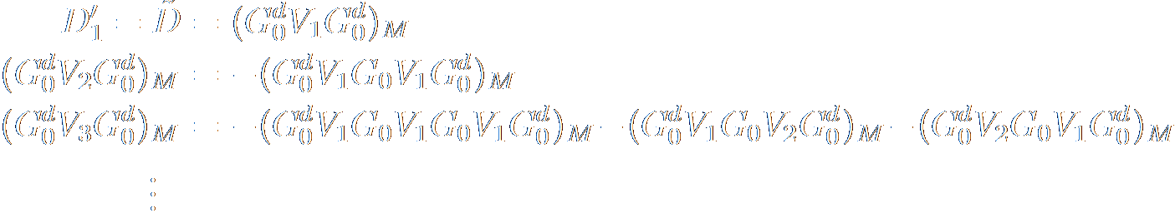
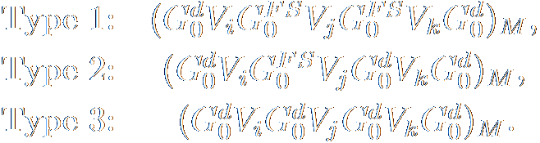

Theory
Free surface removal subseries
  Inverse scattering subseries terms
Types of terms:
We select type 1 (the only task is to create free surface multiples):

Slide 23
Theory
ISS algorithm
  Identify task-specific terms in the entire series
    e.g.: identify the terms responsible for free surface multiple removal
  Employ the subseries to perform the specific task (data processing)
    e.g.: apply free surface multiple removal subseries to the dataset and obtain a processed dataset with multiples removed
  Restart the problem using the processed data as new input
    e.g.: the internal multiple attenuation uses the data with free surface multiples removed as input

Slide 24
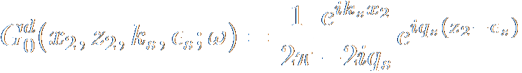
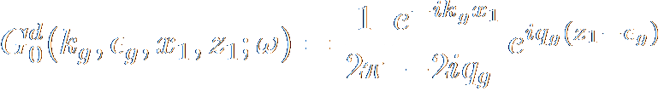
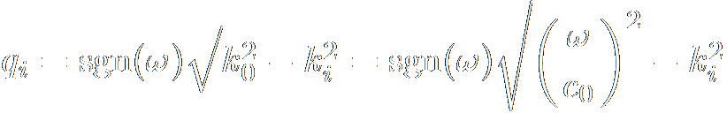
Theory
Free surface removal subseries
  Computation of the first term

Slide 25
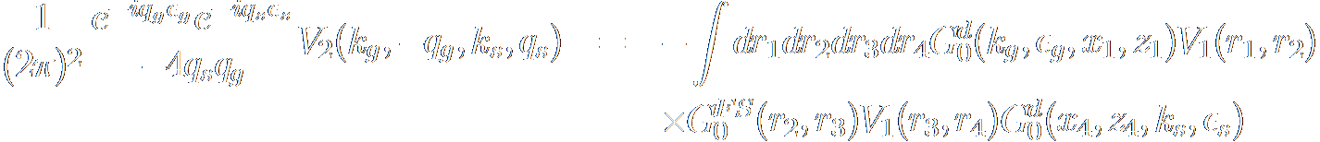
Theory
Free surface removal subseries
  Computation of the second term
From first ISS equation:

Slide 26
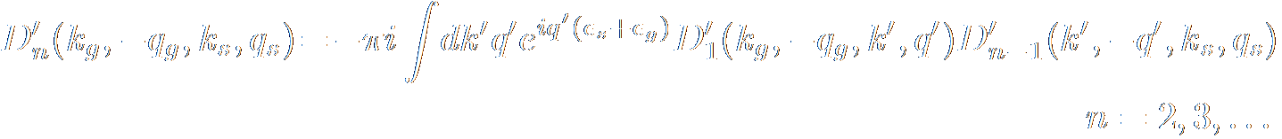
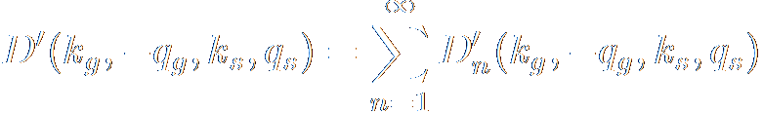
Theory
Free surface removal subseries
  Recurrence relations
  Free surface removed data
  In practice: subtract multiple prediction from original data

Slide 27
Theory
ISS algorithm
  Identify task-specific terms in the entire series
    e.g.: identify the terms responsible for free surface multiple removal
  Employ the subseries to perform the specific task (data processing)
    e.g.: apply free surface multiple removal subseries to the dataset and obtain a processed dataset with multiples removed
  Restart the problem using the processed data as new input
    e.g.: the internal multiple attenuation uses the data with free surface multiples removed as input

Slide 28
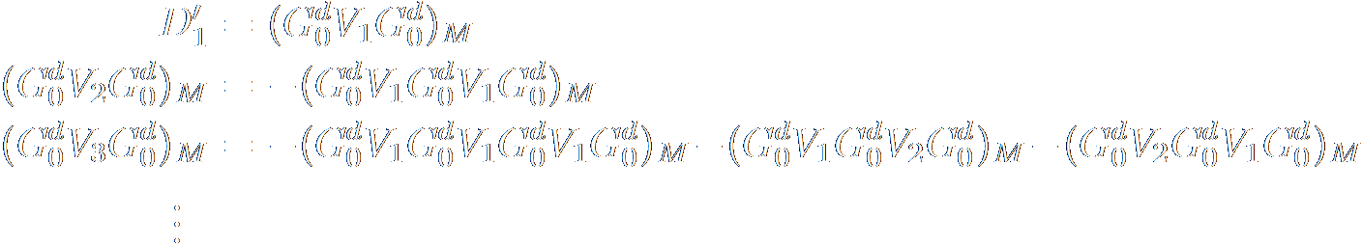
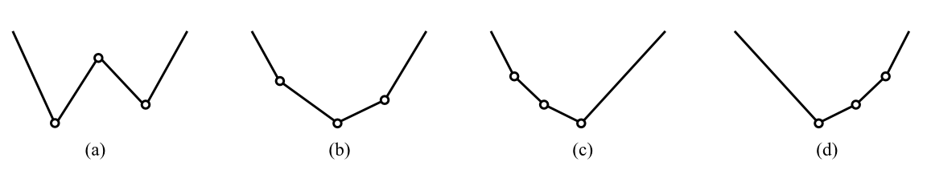
Theory
Internal multiple attenuation subseries
  Inverse scattering subseries terms
  The internal multiple terms are more difficult to map
  Remember the forward series!

Slide 29
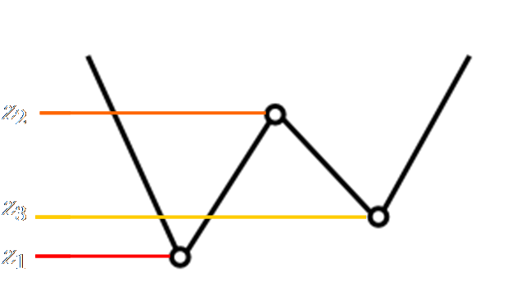
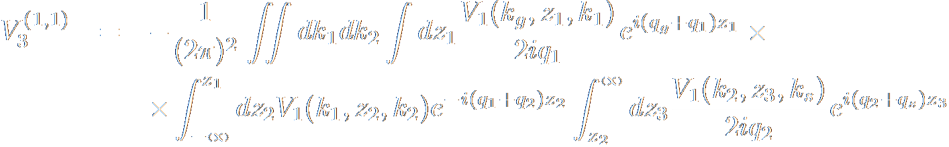
Theory
Internal multiple attenuation subseries
  Inverse scattering subseries terms

Slide 30
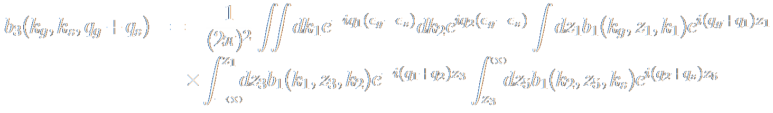
Theory
Internal multiple attenuation subseries
  Inverse scattering subseries terms
From previous slide:
Leading first order multiple attenuation term:

Slide 31
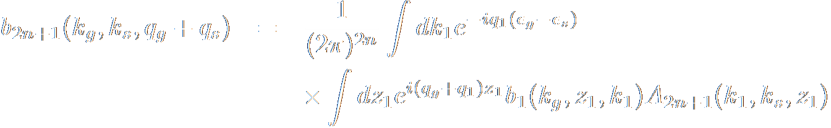
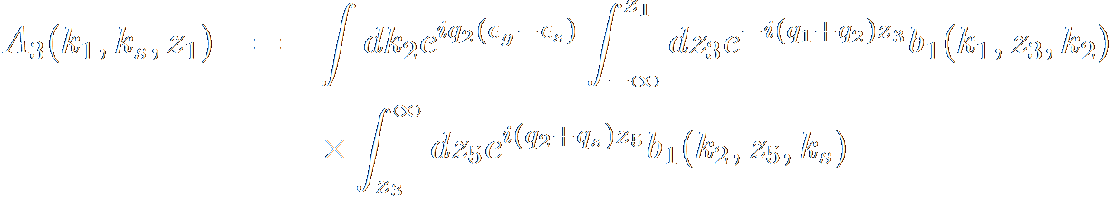
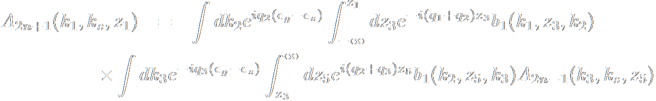
Theory
Internal multiple attenuation subseries
  Recursion relations

Slide 32
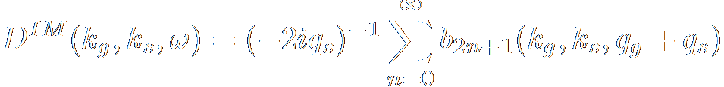
Theory
Internal multiple attenuation subseries
  Internal multiple attenuated data
  In practice: subtract multiple prediction from original data

Slide 33
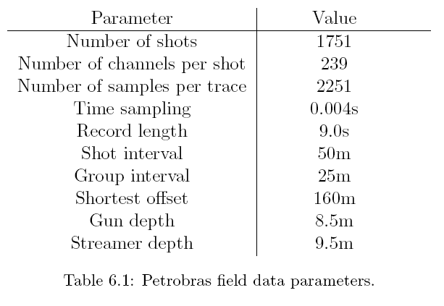
Application to real data
Seismic survey parameters
Notes:
33

Slide 34
Data processing
Pre-processing
  Deghosting
    Applied in Petrobras America
    Reliable and efficient method
  Processing geometry
    Coordinates from header changed for fictitious coordinates
    Processing lattice is a horizontal line of station points
    Offsets regularized (25m)
Notes:
34

Slide 35
Data processing
Pre-processing
  Regularization and interpolation
Seismic survey parameters:
3501
245
25m
Zero offset
ISS works with shots and receivers at every station point of the processing lattice
Shot interpolation required!
Notes:
35

Slide 36
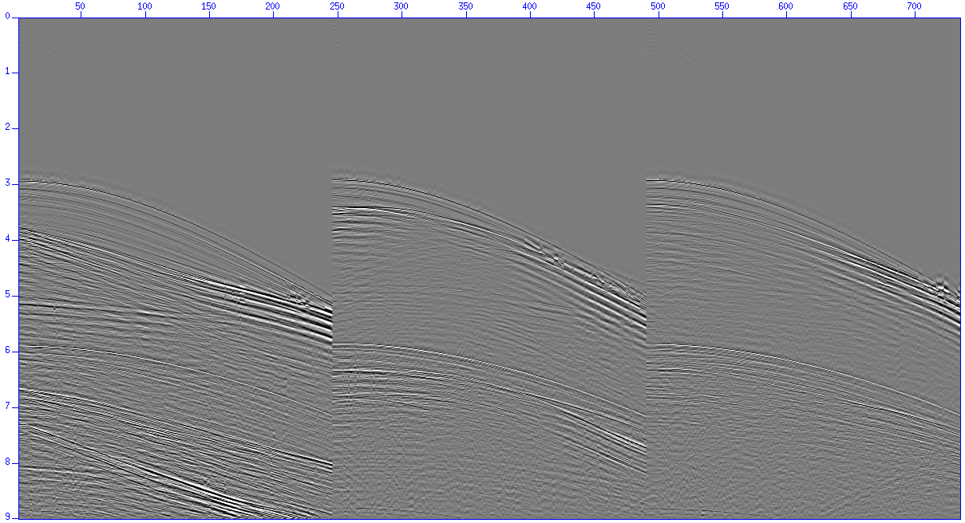
Data processing
Pre-processing
  Source receiver reciprocity
Used to obtain complete split-spread shots
Notes:
36

Slide 37
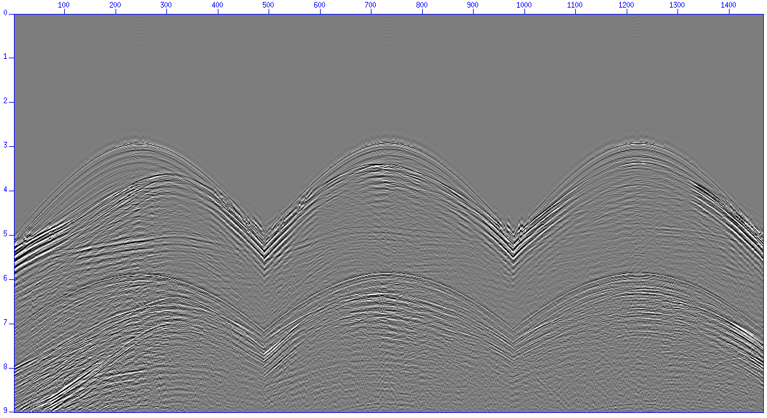
Data processing
Pre-processing
  Source receiver reciprocity
Used to obtain complete split-spread shots
Notes:
37

Slide 38
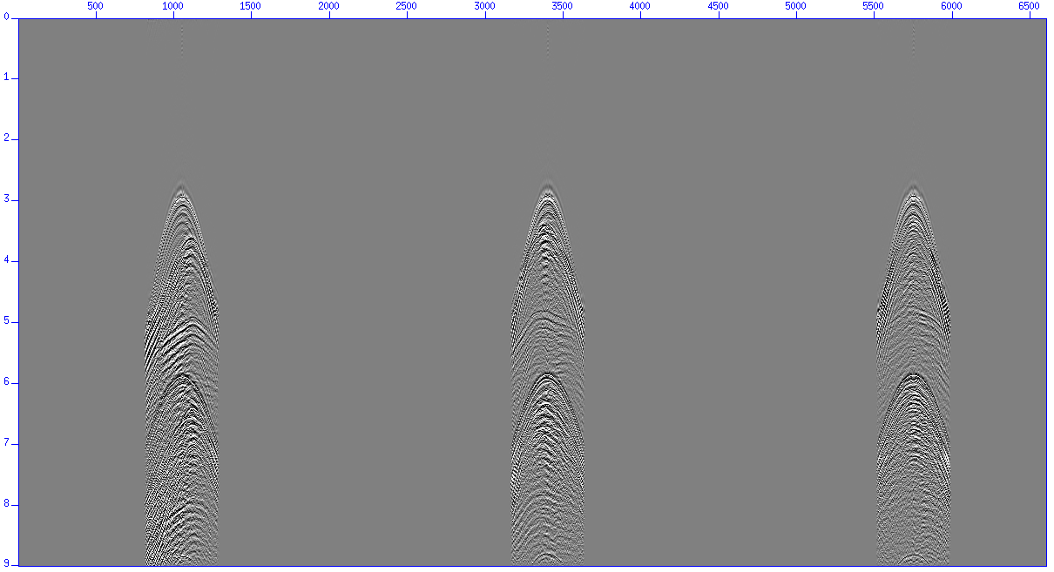
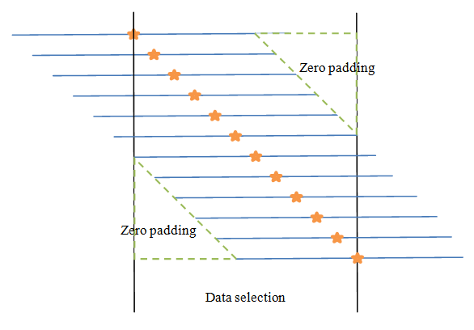
Data processing
Pre-processing
  Trace padding and tapering
Create receiver points at every station to each shot
Notes:
38

Slide 39
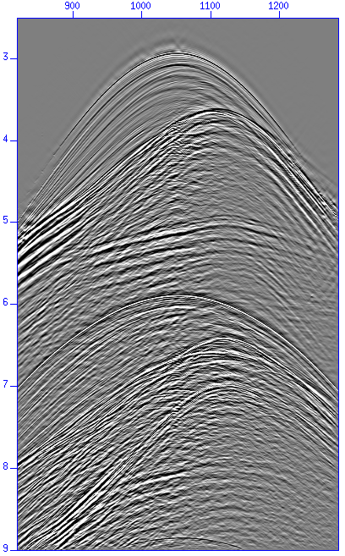
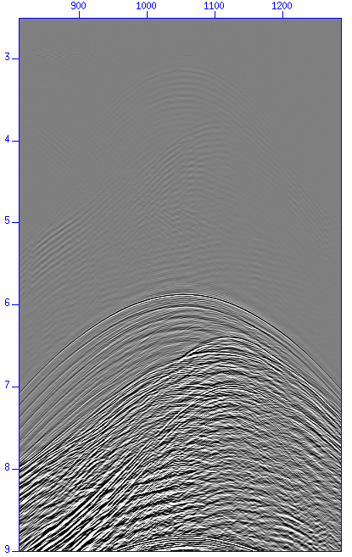
Multiple attenuation
Free surface multiple attenuation
  Multiple prediction
Shot gather
Corresponding multiple
prediction
Notes:
39

Slide 40
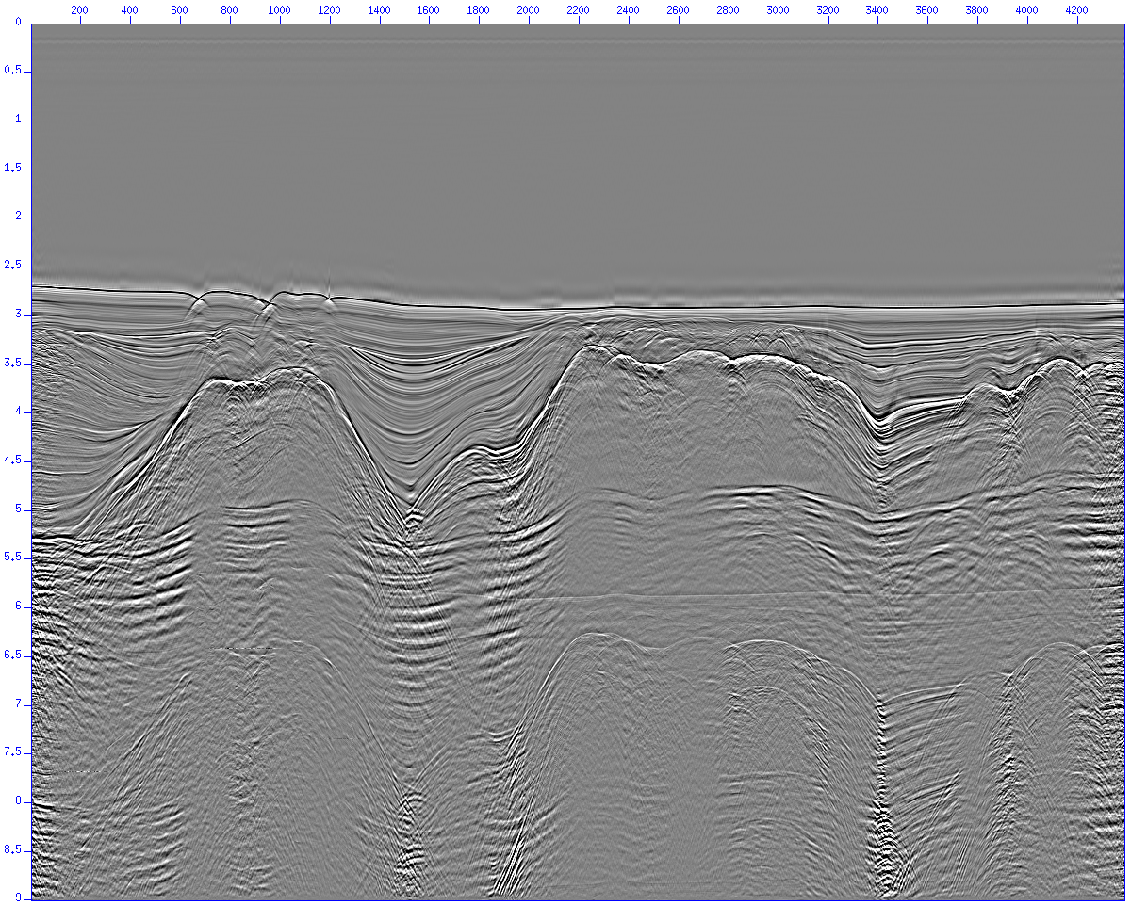
Multiple attenuation
Free surface multiple attenuation
  Stack before free surface multiple removal
Notes:
40

Slide 41
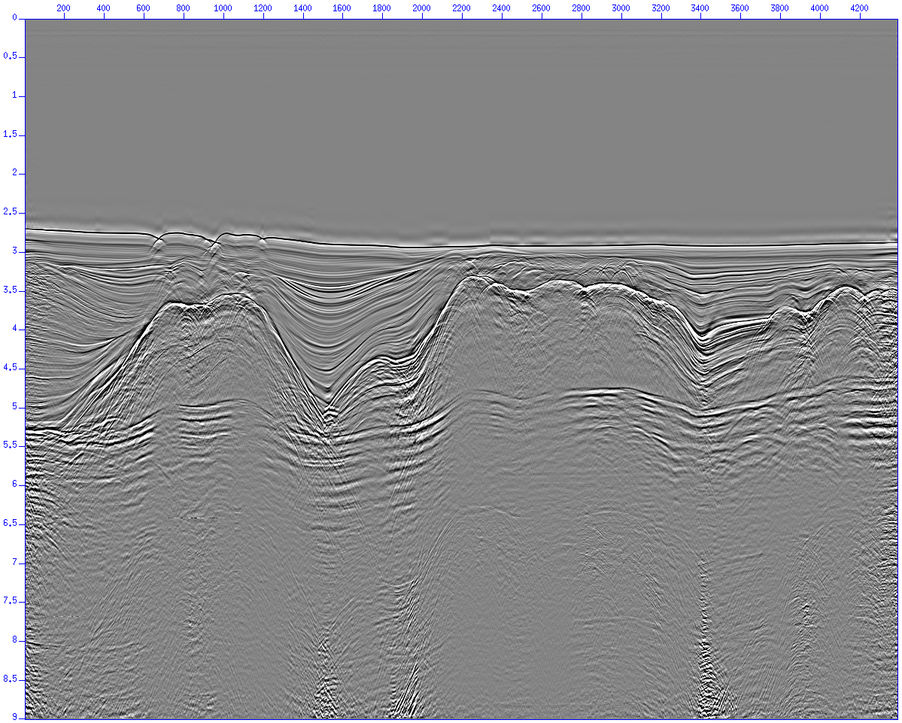
Multiple attenuation
Free surface multiple attenuation
  Stack after free surface multiple removal
Notes:
41

Slide 42
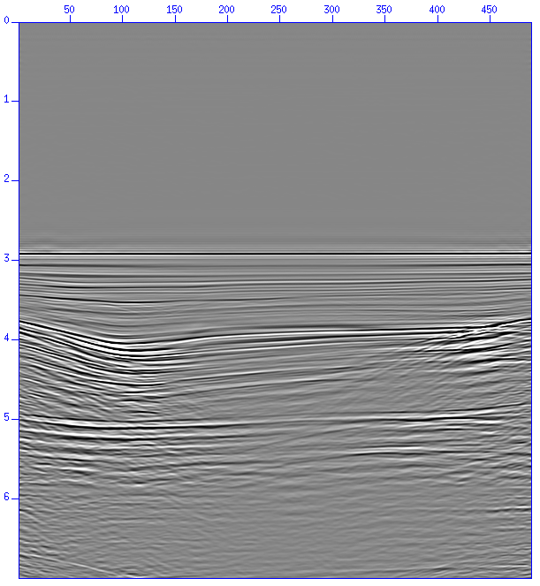
Multiple attenuation
Internal multiple attenuation
  The internal multiple high computer cost process
Notes:
42

Slide 43
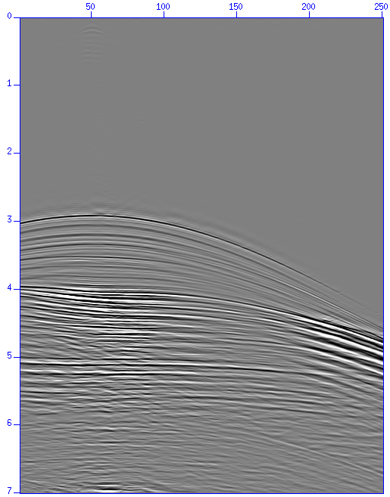
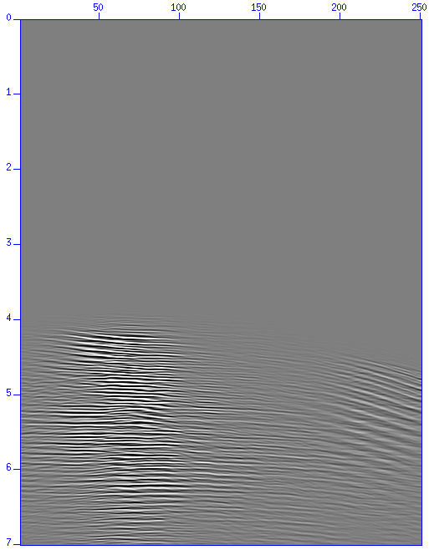
Multiple attenuation
Internal multiple attenuation
  Multiple prediction
Shot gather
Corresponding multiple
prediction
Notes:
43

Slide 44
Multiple attenuation
Internal multiple attenuation results
  Stacked section used to test the internal multiple code

Slide 45
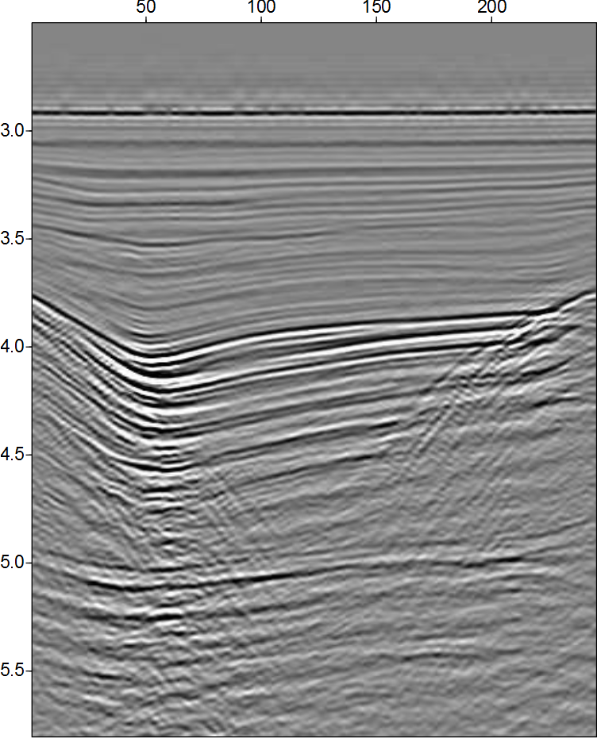
Multiple attenuation
Internal multiple attenuation results
  Common offset sections

Slide 46

Multiple attenuation
Internal multiple attenuation results
  Common offset sections

Slide 47
Multiple attenuation
Internal multiple attenuation results
  Stacked sections

Slide 48
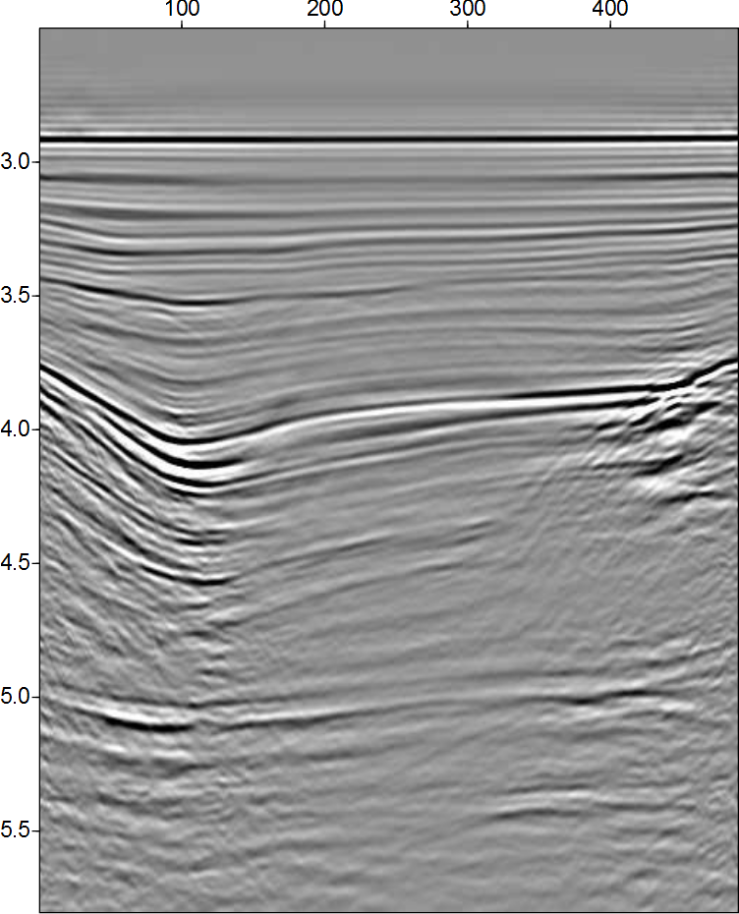
Multiple attenuation
Internal multiple attenuation results
  Stacked sections

Slide 49
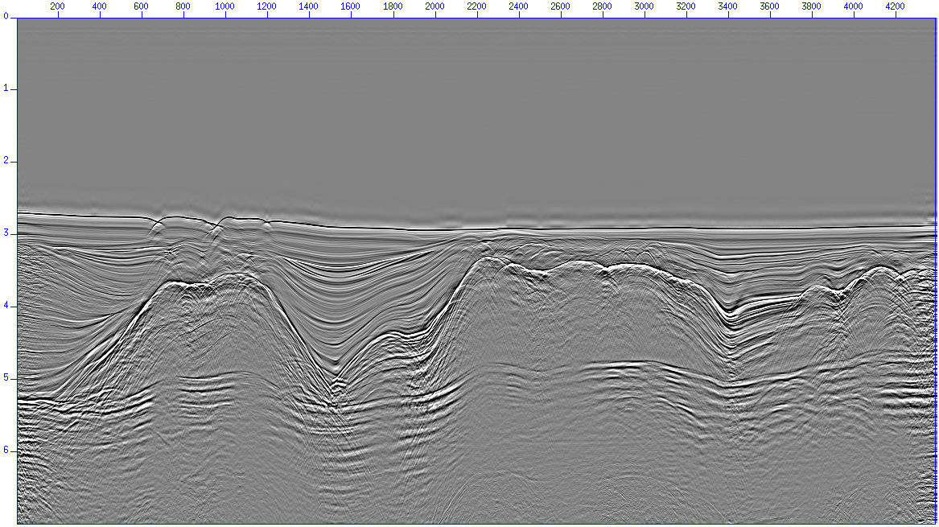
Multiple attenuation
Internal multiple attenuation results (stacked sections)

Slide 50
Multiple attenuation
Internal multiple attenuation results (stacked sections)

Slide 51

Multiple attenuation
Internal multiple attenuation results (stacked sections)

Slide 52
Conclusions
Multiple removal/attenuation is a major problem in seismic exploration
Free surface multiple removal results
  Multiple prediction is excellent
    Improved when source wavelet information was provided
  Anti-alias filter application is important
  Multiples from 3D structures are attenuated but not removed
  Adaptive subtraction required
Internal multiple attenuation results
  Multiple prediction is excellent
  Very high computer cost (both CPU time and memory)
  Adaptive subtraction required

Slide 53
Conclusions
ISS methods were able to attenuate both free surface and internal multiples in a very complex situation
  No a priori information about the dataset is necessary
  No other tested method was able to attenuate the sequence of internal multiples below the salt layers
  High computer cost (internal multiples)
  Adaptive subtraction requirement

Slide 54
Future work
Test other adaptive subtraction methods
Use well log information to map primaries close to the well
Comparison between current result and results obtained by other multiple attenuation methods
Internal multiple eliminator

Slide 55


Acknowledgments
Dr. Weglein, Dr. Terengui and Dr. Hsu
Petrobras
M-OSRP group
University of Houston

Slide 56
Multiple attenuation
Internal multiple attenuation

Slide 57
References
Carvalho, P. M., Weglein, A. B., and Stolt, R. H., 1991, Examples of a nonlinear inversion method based on the T matrix of scattering theory: application on multiple suppression, 61st Ann. Mtg., SEG, Expanded abstracts, 1319-1322
Carvalho, P. M., Weglein, A. B., and Stolt, R. H., 1992, Nonlinear inverse scattering for multiple suppression: application to real data, Part I, 62nd Ann. Mtg., SEG, Expanded abstracts, 1093-1095
Weglein, A. B., Boyse, W. E., and Anderson, J. E., 1981, Obtaining three-dimensional velocity information directly from reflection seismic data: an inverse scattering formalism, Geophysics, 46, 116-1120
Weglein, A.B., Gasparotto, F.A., Carvalho, P.M., and Stolt, R.H., 1997, An inverse scattering series method for attenuating multiples in seismic reflection data, Geophysics, 62, 1975-1989
Weglein, A. B., 1999, Multiple attenuation: an overview of recent advances and the road ahead, The Leading Edge, 1, 40
Weglein et al., 2003, Inverse scattering series and seismic exploration, Inverse Problems, 19-6, R27-R83.

